Slide 1
Animatronics
Python with Robots Mission 4
Lesson 2 Objectives 4-7

Slide 2

Pre-Mission Warm-Up
In your Mission 4 Lesson 2 log, answer the pre-mission warm-up questions:
What line of code increments a counter?
How can you avoid a ValueError?

Slide 3
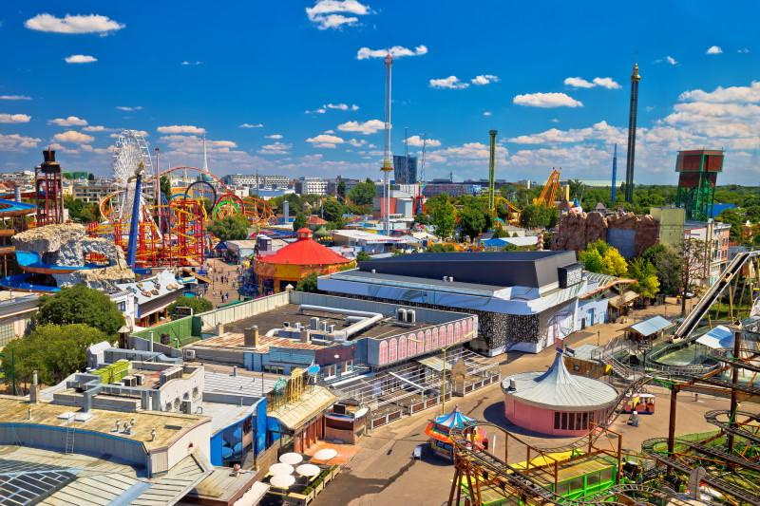
Mission 4: Animatronics
Review: You are hired by a major Theme Park!
Your task is to create a new animatronic robot exhibit.
Gotta write some Python code and get the show running with CodeBot!

Slide 4
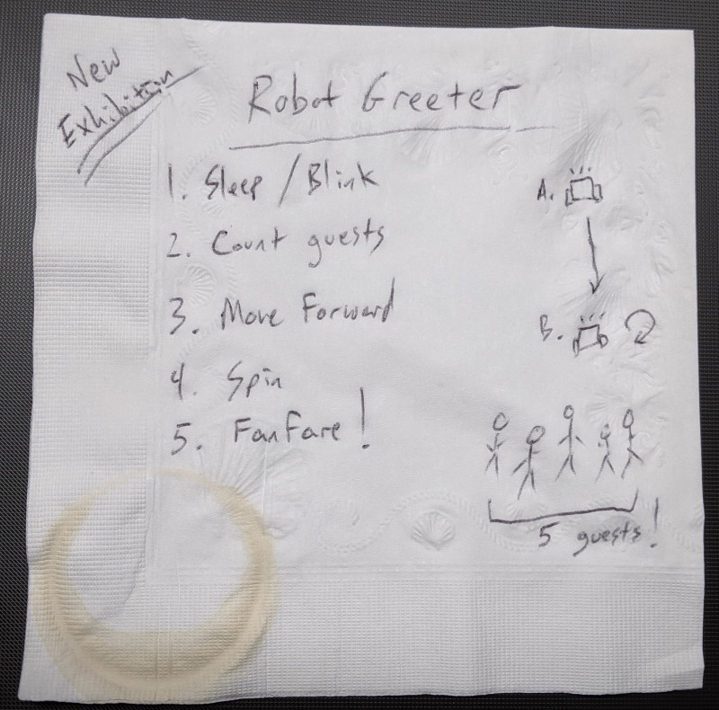
Mission 4: Animatronics
We will work on the next task:
Task:
Each guest presses a button as they enter the small entrance room.
When 5 guests have entered, the show starts!
Goal: Count the guests!

Slide 5
Mission 4 Introduction Activity
DO THIS:
Answer the questions in your Lesson 2 log.
What is the second step outlined in the notes?
What is the second project goal?

Slide 6
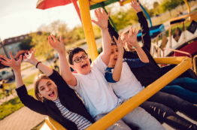
Objective #4: Counting the Guests - part 1
For this objective, you will
Count the number of BTN-0 presses.
When the count reaches 5, you need to break out of the loop so the robot can do the next step.
Is there a Python statement to break out of a loop?

Slide 7
Objective #4: Counting the Guests - part 1
Glad you asked!
Use a statement called …. break
This simple statement exits the nearest enclosing loop.
When the computer runs a break statement, it immediately exits the closest while True: loop.

Slide 8
Objective #4 Activity
DO THIS:
Start a new file – CountGuests
Type in the code on the next slide.
Watch your indenting!
Run the code.
The first user LED (LED 0) should flash on and off.
When you press BTN-0, the program should stop.

Slide 9
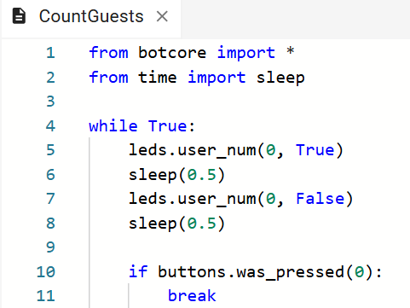
Objective #4 Activity

Slide 10
Objective #5: Counting the Guests - part 2
Now you can add the actual guest count, and increment it every time BTN-0 is pressed.
Increment means to add one, like counting.
You can also display the number of guests using the green line sensor LEDs.
Line sensor LEDs use the code: leds.ls_num()

Slide 11
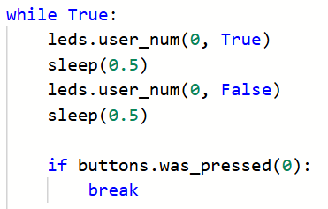
Objective #5 Activity
DO THIS:
Delete the lines of code that blinked user LED 0:

Slide 12
Objective #5: Counting the Guests - part 2
Add this to your code:
Define a variable for the number of guests.
Call it n_guests.
The initial value of n_guests will be 0.
It is assigned above the infinite loop.

Slide 13
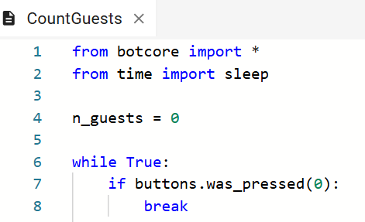
Objective #5 Activity
DO THIS:
Define and initialize a variable for guests:

Slide 14
Objective #5: Counting the Guests - part 2
Add this to your code inside the loop:
Turn on the line sensor LED corresponding to n_guests.
Increment n_guests each time BTN-0 is pressed.
If n_guests == 5, break out of the loop.
Can you do these steps on your own?

Slide 15
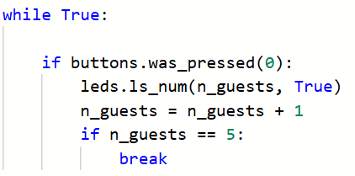
Objective #5 Activity
DO THIS:
Add code to the if statement:

Slide 16
Objective #5 Activity
DO THIS:
Run the code.
Press BTN-0 slowly, several times.
Record what you observe in the mission log.

Slide 17
Objective #6: Beep Beep, I’m a Bot!
Let’s upgrade the code with another feature.
Beep when a button is pressed.
This objective uses two basic functions of CodeBot’s speaker:
spkr.pitch(440)
This starts playing a tone at a given frequency in Hertz (440Hz)
spkr.off()
Stops the speaker

Slide 18

Objective #6: Beep Beep, I’m a Bot!
Use the function spkr.pitch(440) to start a tone.
Wait a short delay.
Then use spkr.off() to stop playing the tone.
Kind of like blinking an LED.
You will add this beep to your button press code block.

Slide 19
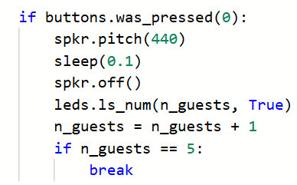
Objective #6 Activity
DO THIS:
Add beeps to your code. Then run the code.

Slide 20
Objective #7: Beep Beep 2
One more thing – Debouncing the Button
When you pressed the button, did it sometimes seem like a double press?
Did two lights turn on instead of one?
That is a button bounce, and we need to fix that.
You may have observed that there is less of a bounce with the beeps, than before adding the beeps.
The delay between speaker functions helps, but we can do more.

Slide 21
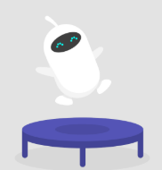
Objective #7: Beep Beep 2
was_pressed() – how it works:
First, the function returns True if a button has been pressed.
Then it resets the internal status of the button to False.
This reset makes it so it won’t return True again unless the button was pressed again since the last press.
But sometimes the metal contact in the button doesn’t settle, and was_pressed() is set to True – again!

Slide 22
Objective #7: Beep Beep 2
Bad Bounce! When the button bounces, here’s the sequence:
User presses button.
First contact!
was_pressed(0) is set to True
Internal status reset to False.
But then the button bounces!
was_pressed(0) is set to True again, even though another button press didn’t happen.

Slide 23
Objective #7: Beep Beep 2
Let’s Debounce!
Detect a button press.
Delay long enough for the bouncing contacts to settle down.
Reset internal button press status.

Slide 24
Objective #7: Beep Beep 2
Let’s Debounce!
Your code already does the first two steps.
Detect a button press
Delay (this is in between the speaker functions
So now you just need to reset the internal button press status.
Just call buttons.was_pressed(0) again!

Slide 25
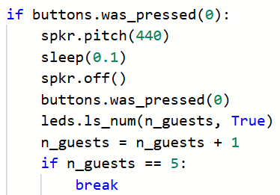
Objective #7 Activity
DO THIS:
Add the code to reset the internal status of the button. Then run the code.

Slide 26

Mission quiz
Now …. time for a quiz!
Answer the four quiz questions in CodeSpace.
CODEX
QUIZ

Slide 27
Extensions
Here are some things to try:
Use the user LEDs to display the number of guests. Go up to 8 guests before breaking the loop.
Use the user LEDs to display the number of guests. Get a random number between 5 and 8 to break the loop, so it can be a different number.
Change the tone of the beep with every button press.

Slide 28
Post-Mission Reflection
Complete the post-mission reflection in your Mission 4 Lesson 2 Log:
How are while loops and if statements similar?
How are while loops and if statements different?

